Slide 1
Microsoft Pictures Presents
Where to Invest in Profitable Film Projects
Analysis by Patrick Anastasio

Slide 2
Business Summary
Analysis of industry data reveal opportunities for success and profitability through smart investment in:
Popular and highly rated genres
With a proven net profit in the domestic market
Attached names of buzzworthy directors and talent

Slide 3
Outline
Business Problem
Data
Methods
Results
Conclusions

Slide 4
Business Problem
Movies are as much a business as an artform.
Many try to run a profitable production house... Most fail!
As a fledgling production company, Microsoft is unsure what projects will ensure success. What projects will be profitable, popular, and bring buzz to the company?

Slide 5
Data
Datasets from movie aggregation sites:
Movies by title, ratings, audience votes, genres, names of directors/writers/actors, budgets and domestic box office numbers.
Primarily looking at financials and analyzing movies that meet a certain financial bar
Box Office Mojo
IMDB
Rotten Tomatoes
TheMovieDB
The Numbers

Slide 6
Methods
I have used data aggregation methods, statistics, and visualizations to isolate trends and to show what and who has been successful in the industry.
I merged several datasets from different sources and extracted the relevant information.
I then used comparative statistics, regression and correlation to analyze the data
Finally, I used visualization methods to show the results of my analysis

Slide 7
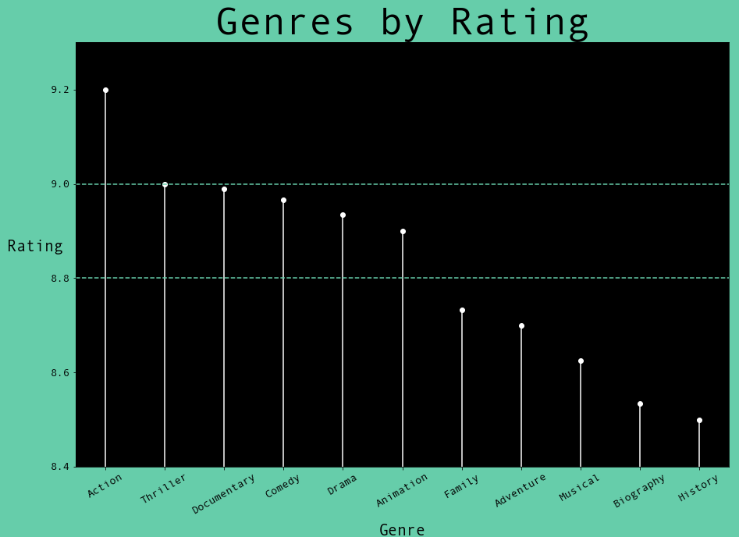
Results
POPULAR GENRES
After comparing the average rating of movies and looking at the genres they fell in, we can see the highest rated movies were Action ...by a wide margin.
Other popular genres are Thriller, Documentary, Comedy, Drama, and Animation.

Slide 8
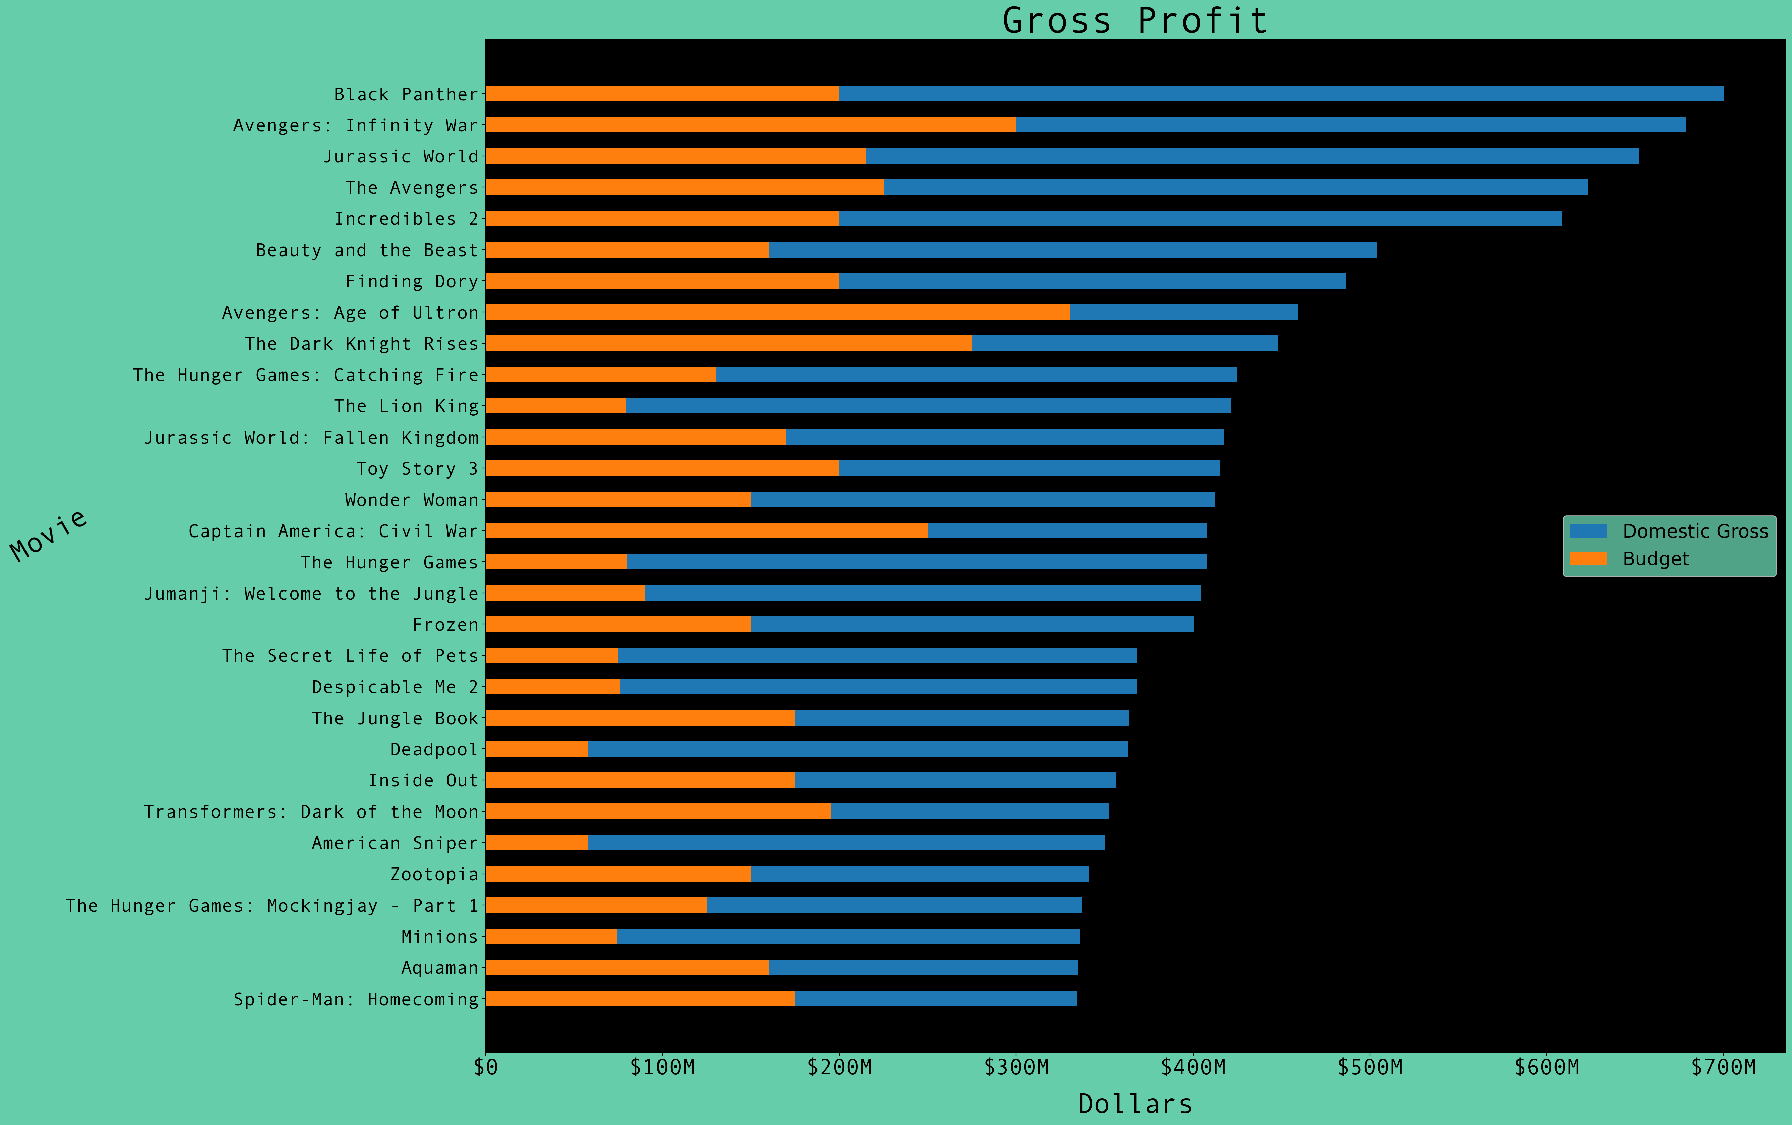
Results
Profitable Movies
Taking the domestic box office gross of the top 30 movies from the last decade, and comparing this to their budget, we can see the most profitable movies
18 were in the action genre,
All but 1 were part of a franchise
10 of these were super-hero / comic book movies
12 were in the animation genre, some franchises as well

Slide 9
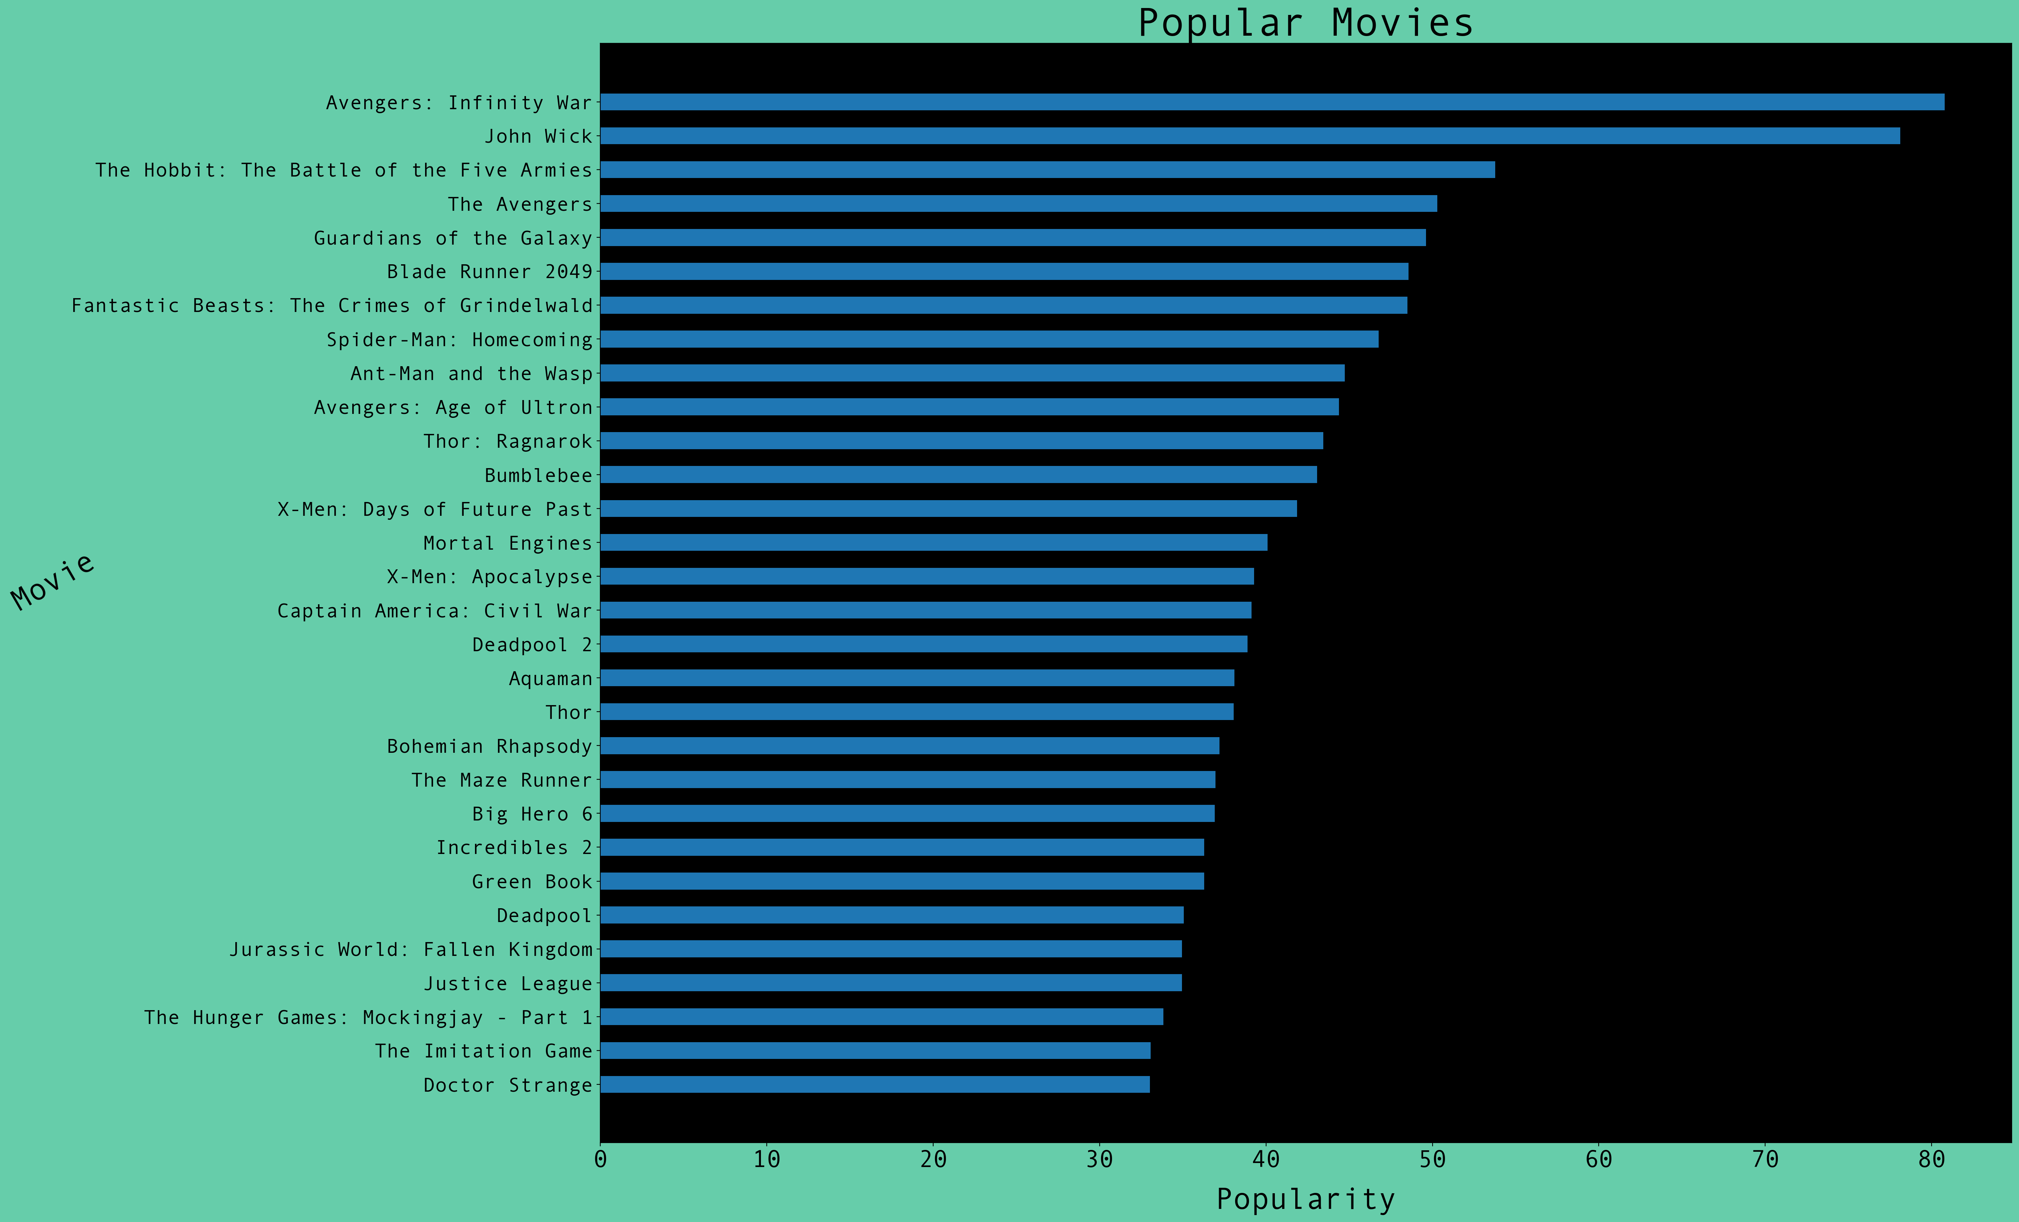
Results
Popularity
Looking at the popularity scores of the top 30 movies from the last decade
22 were in the action genre, All but 1 were part of a franchise
16 were super-hero / comic book movies
All part of franchises
3 were animation
3 were drama
2 were fantasy franchises

Slide 10


Results
Comparing popularity scores to both box office gross and budget, and looking at the regression line, we see a slight positive correlation between popularity and higher budgets, and obviously domestic gross (which itself is a measure of popularity).
Higher budget movies are potentially more popular and bring in more gross revenue

Slide 11
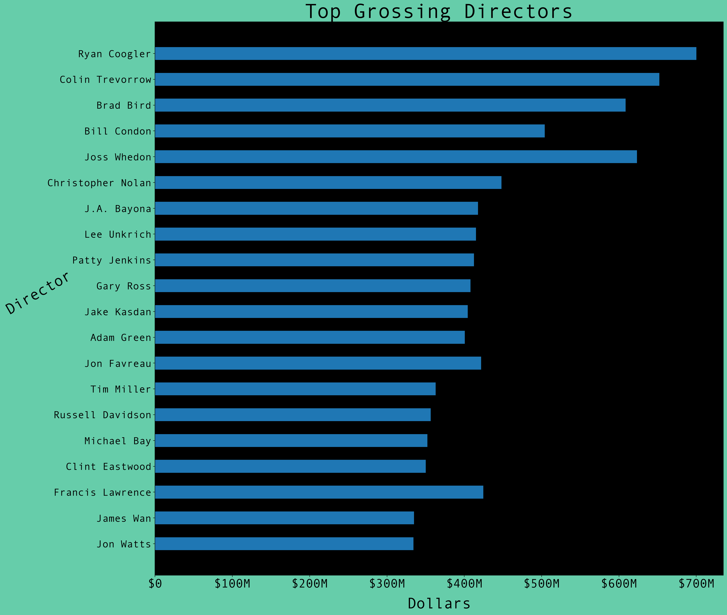
Results
Top Grossing Directors
Of the top 30 grossing movies from the last decade, these 20 directors were at the helm of at least one of those.

Slide 12
Conclusions
Microsoft should look to acquire the rights to a super-hero / comic book franchise, or possibly another type of action franchise (e.g., Hunger Games)
______
The most popular genre, by far, is the action genre
Within this genre, the most successful movies by both profitability and popularity were in the superhero / comic book sub-genre
Most were part of a franchise of films

Slide 13
Conclusions
Microsoft should look to produce animated movies as well
12 of the top 30 most profitable movies were animated
Animation was also one of the most popular genres
______
Microsoft should attach top grossing directors and talent to their projects.
Top talent will bring buzz and notoriety, which will bring audiences and profits

Slide 14
Thank You!
Email: sudomakecoffee1@gmail.com
GitHub: @patrick-anastasio
LinkedIn: linkedin.com/in/patrickanastasio/

